Slide 1

TS-WEB/CC/AI TRACK CAPSTONE PROJECT ONLINE VENUE reservation SYSTEM
Presented By:-SNEHA KATAM
SOUJANYA
TULASI
DEEPIKA
Guide by:- RADHA UMA

Slide 2
Outline
Abstract
Existing System
Proposed System
Proposed System Advantages
Hardware System Configuration
Software System Configuration
Software Environment
System Design (Uml Diagrams)
System Design(Use Case Diagram)
Modules
Sorts Of Tests
Conclusion
Bibliography

Slide 3
Abstract
Venue booking system is a web application in which dealers and customers can add and book the events based on their location, availability, and area. This makes the workload simple for users to book an event they need to search for it. In this application, the user needs to be registered and log in and user will search for venues by giving the location if the venues were present in the particular location.

Slide 4
Existing System
In the present world the reservation of venues are done through some agencies, electronic services and venue providers. The user can make arrangements face to face with the agent and can make depending on services provided by the agency. Through venue provider, user can make arrangements and have a direct contact with the provider.

Slide 5
Proposed System
To overcome the above problems we came up with an idea to implement a system called Suburb Possessor ship.
The System that is developed will help the users to plan their reservations for functions, parties, weddings, meetings etc., by not getting into troubles through some agencies. They can enter into a single site which provides vacancies and profile of different venues. This provides a solution for smooth running of the schedules of the users.

Slide 6
Proposed System Advantages
1. Users need not go to venues provider for
booking venues
2. Our system also helps venue provider since
they can personally reserve venues for
users which are also through our system.
3. Our system provides profile of different
venues. So users can find different venues at
single place.

Slide 7
Hardware System Configuration
Processor - intel core i5(4th gen) (min)
RAM - 4GB
Hard Disk - 128 GB
Key Board - Standard Windows Keyboard
Mouse - Two or Three Button Mouse
Monitor - SVGA(super video grapic array)

Slide 8
Software System Configuration
Operating System : Windows 7/8/8.1/10/11
Application Server : Tomcat5.0/6.X
Front End : HTML, Java, css
Scripts : JavaScript.
Server side Script : Java Server Pages.
Database : Mysql 5.5
Database Connectivity : JDBC.

Slide 9
Software Environment
Java Technology
Java technology is both a programming language and a platform.
The Java Programming Language
The Java programming language is a high-level language that can be characterized by all of the following buzzwords:-
(1) Simple (6) High perfomance
(2) High perfomance (7) Multi-threaded
(3) Oject oriented
(4) Portable
(5) Distributed

Slide 10
System Design (Uml Diagrams)
UML stands for Unified Modeling Language. UML is a standardized general-purpose modeling language in the field of object-oriented software engineering.
The goal is for UML is to become a common language for creating models of object oriented computer software.

Slide 11
System Design(Use Case Diagram)
A use case diagram in the Unified Modeling Language (UML) is a type of behavioral diagram defined and created from a Use-case analysis.
Its purpose is to present a graphical overview of the functionality provided by a system.

Slide 12
Url Diagrams Venue Provider Usercase Diagram

Slide 13
Visitor Usercase Diagram

Slide 14
Admin User Case Diagram

Slide 15
Class Diagram

Slide 16
Sequence Diagaram

Slide 17
Modules
The system is proposed to have the following modules:
(1) Registration
(2) Search
(3) Reservation
(4) Cancellation
(5) Venues Profile submission

Slide 18
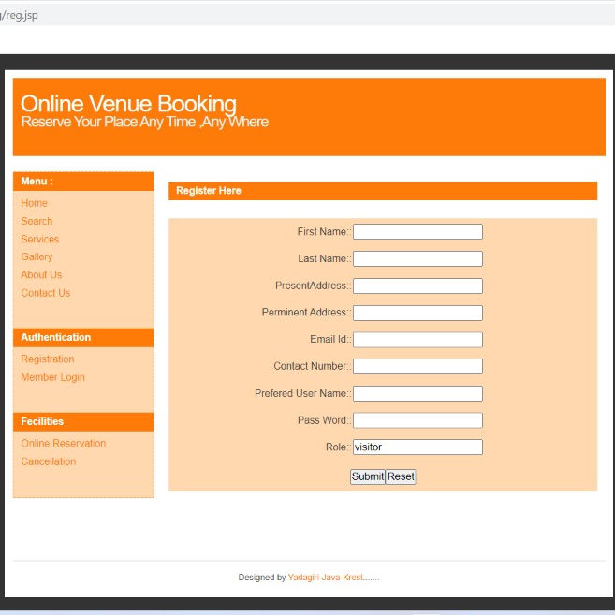
Registration
The registration module deals with the intake of complete details of the user and venues. The user has to enter the personal details.

Slide 19
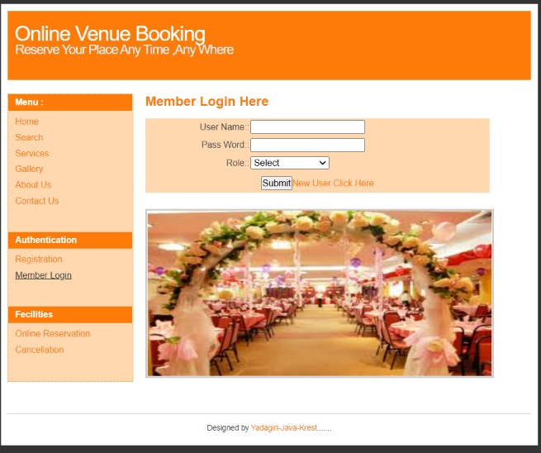
Search
The search module allows users to search for venues of their desire. The user has to just specify the place. The profile of all the venues in that place are displayed to the user.

Slide 20
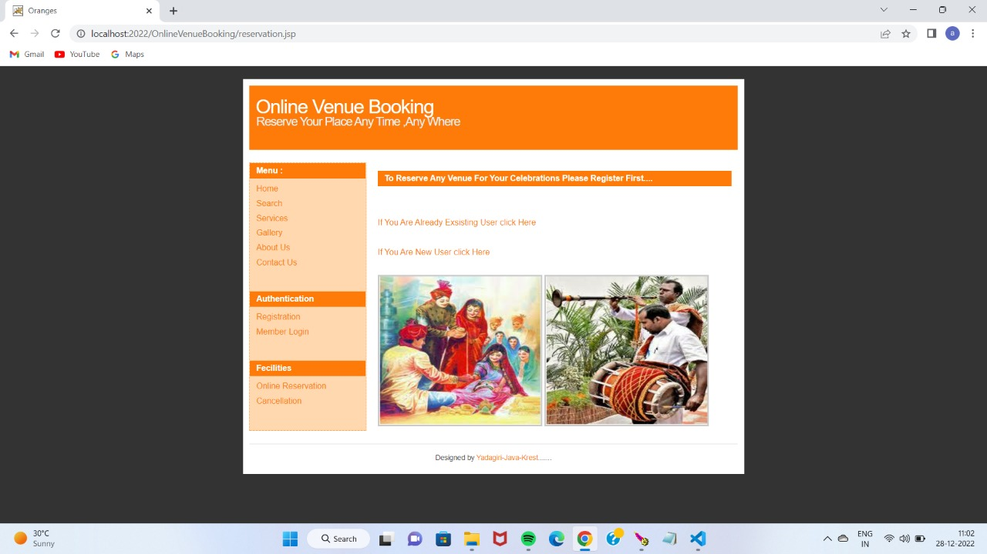
Reservation
In this module the user has to tell the venue name, check-in date, check-in and checkout times in-order to reserve a venue.

Slide 21
Cancellation
The user has the facility to cancel a venue. For cancellation the user should login and provide the details of the venue he already reserved.

Slide 22
Venues Profile Submission
This module deals with the venue provider. Venue Provider will provides the details of the venue like venue name, address, capacity, cost, contact numbers etc. When the users search for a venue these details will be displayed.

Slide 23
Sorts Of Tests
(1) Unit Testing
(2) Integration Testing
(3) Combination Testing
(4) Discovery Testing
(5) Acceptance Testing

Slide 24
Unit Testing
Unit testing is a type of software testing where individual units or components of a software are tested.
Unit Testing of software applications is done during the development (coding) of an application.

Slide 25
Integration Testing
Integration testing is the process of testing the interface between two software units or module. It’s focus on determining the correctness of the interface. The purpose of the integration testing is to expose faults in the interaction between integrated units

Slide 26
Combination Testing
Combination testing is a testing technique in which multiple combinations of the input parameters are used to perform testing of the software product.
The aim is to ensure that the product is bug-free and can handle different combinations or cases of the input configuration.

Slide 27
Discovery Testing
Discovering the weaknesses is one way to provide evidence that the design team’s set of assumptions are justified. It also helps the team gather information on areas that have plenty of design margin.
Finding design weaknesses early in the design process permits the team to address and correct problems

Slide 28
Acceptance Testing
Client Acceptance Testing may be a basic amount of any task and needs cooperation by the consumer. It likewise guarantees that the framework meets the utilitarian stipulations.

Slide 29
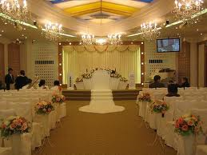
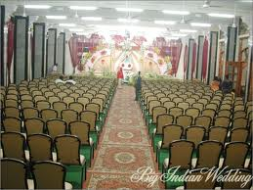
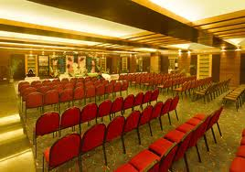
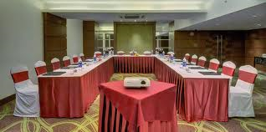
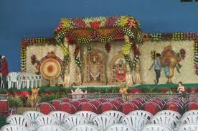
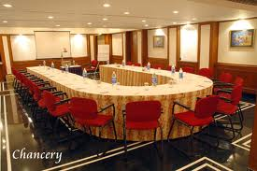
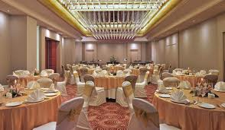
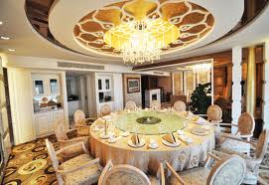
Some pictures of venues

Slide 30
Conclusion
The online venue booking system has been developed to replace the manual process of booking venues such as hotel room or any other facility of hotel .It is quite easy to use and handle.
The old system doesn’t serve the costumer in a better way

Slide 31
Bibliography
1] Data markets compared – a look at data market offerings from four providers. goo.gl/k3qZsj.
[2] Ftc charges data broker with facilitating the theft of millions of dollars from consumers’ accounts. goo.gl/7ygm7Q.
[3] Ftc charges data brokers with helping scammer take more than $7 million from consumers’ accounts. goo.gl/kZMmXn.

Slide 32
THANK

